Slide 1
Data Science
Oct 2018

Slide 2
Oncology Hospital

Slide 3




Problem:
Number of Cancer diagnosis is getting higher.
Less people doing the treatment and more are dying.
Due to this higher demand, our doctors are not able to schedule an appointment to everyone who needs to start the treatment.
What we can do to increase our efficiency in take care of people?

Slide 4

Solution:

Slide 5
Data Science Flow

Slide 6











How do we do?
Collect Data
Collect Data
Labeling
Model
Evaluate
Pre-Deploy
A
R
P

Slide 7



Understanding Data:
Without Cancer
Medical Records
ML Model
Results
With Cancer

Slide 8

Evaluation: Accuracy, Precision and Recall

Slide 9
Evaluation
Accuracy: From the total, how many I got right answer?
Accuracy: |  | Truth
TP+TN/(TP+FP+FN+TN) |  | Positive | Negative
Model | Positive | True Positive | False Positive
 | Negative | False Negative | True Negative
Precision: From the model results, how many were right?
Precision: |  | Truth
TP/(TP+FP) |  | Positive | Negative
Model | Positive | True Positive | False Positive
 | Negative | False Negative | True Negative
Recall: From the input, how many I classified right?
Recall: |  | Truth
TP/(TP+FN) |  | Positive | Negative
Model | Positive | True Positive | False Positive
 | Negative | False Negative | True Negative

Slide 10

Evaluation: Accuracy, Precision and Recall

Slide 11
Model Results
Cancer Treatment |  | Truth
 |  | Have Cancer | Don’t have Cancer
Model | Have Cancer | True Positive | False Positive
 | Don’t have Cancer | False Negative | True Negative
Why and when Recall or Precision?

Slide 12



Evaluation:
True Positive |  | Have Cancer, did the treatment and still alive.
True Negative |  | Do not have Cancer, and didn't take the treatment, still alive.
False Positive |  | Do not have Cancer, suffered due to the invasive unnecessary treatment, but still alive.
False Negative |  | Have Cancer, didn’t undergo treatment and unfortunately dead.

Slide 13



Business Acceptance Criteria:
Increase volume of people receiving treatment.
Reduce deaths by Cancer, even if we let people without Cancer do the treatment.

Slide 14
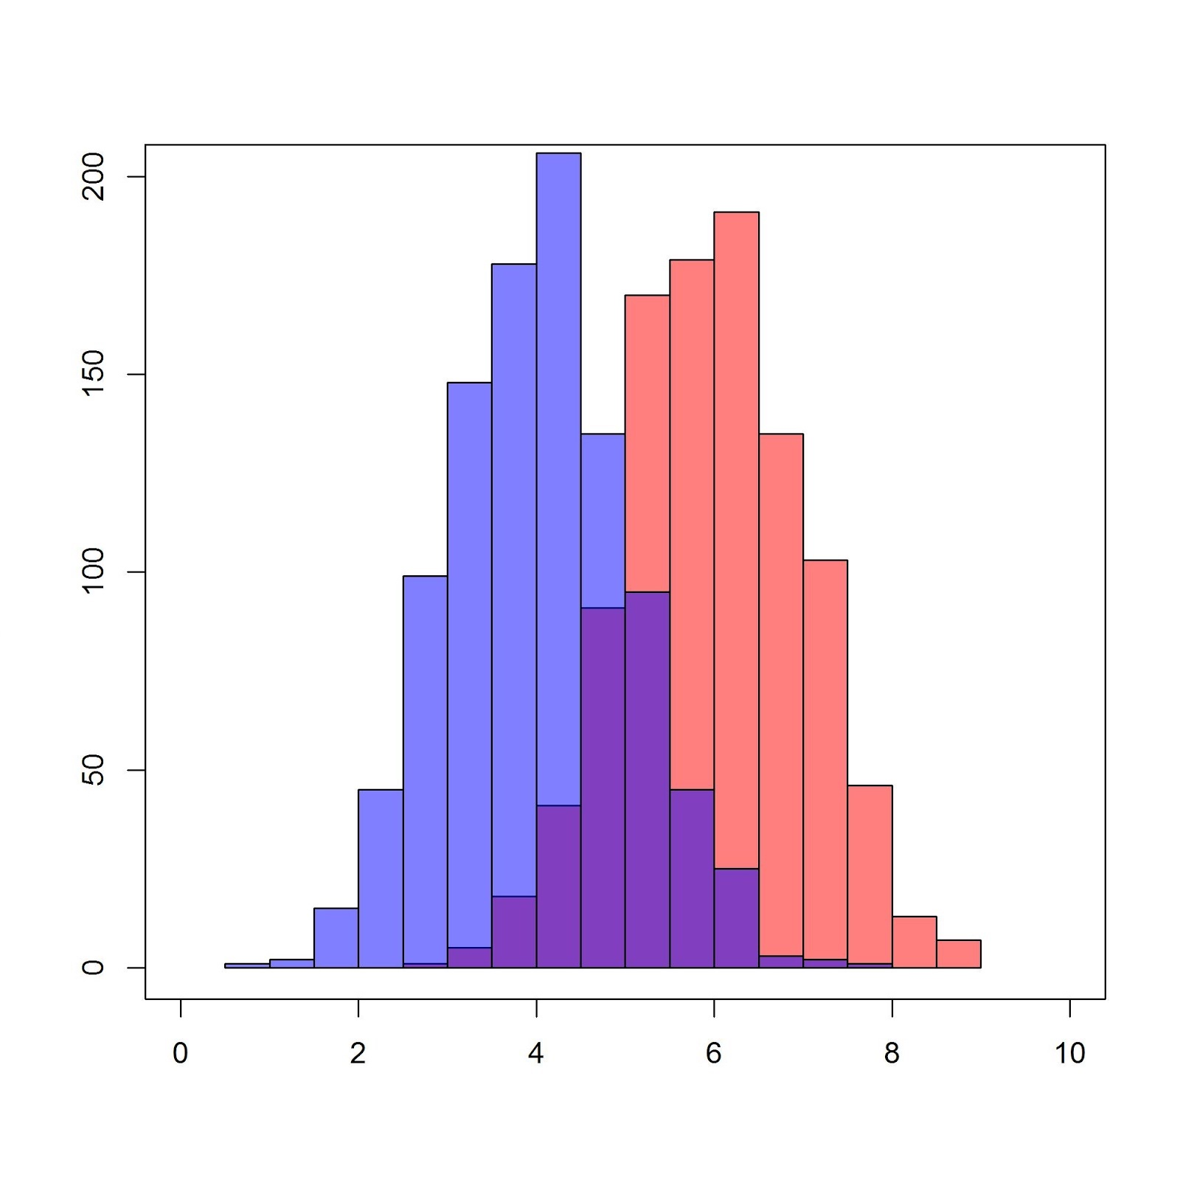
Evaluation: Accuracy, Precision and Recall
Have
Have
Do Not Have
Do Not Have
Do Not Have
Have
Have Cancer class validation
 | Higher Recall |  | Less Precision
 | Reduces False Negatives |  | Increase False Positives
 | Default Recall |  | Default Precision
 | False Negatives |  | False Positives
 | Less Recall |  | Higher Precision
 | Increase False Negatives |  | Reduces False Positives
False Positive |  | Do not have Cancer, suffered due to the invasive unnecessary treatment, but still alive.
False Negative |  | Have Cancer, didn’t undergo treatment and unfortunately dead.

Slide 15

Results
What we should do?
Maximize Precision?
Maximize Recall?
Maximize both?

Slide 16
Questions?

Slide 17
Thank You!

